Slide 1
Applied Deep Learning Homework 1
Kaggle Due: 2022/10/15 23:59
Code/Report Due: 2022/10/17 23:59

Slide 2
UPDATES
Sep 22 23:14: Page 24 update default python version to 3.9
Sep 23 18:08: Update Sample Code
Sep 24 14:11: Update Sample Code
Sep 28 16:42: Change Office Hour
Oct 05 18:08: Add nltk
Oct 10: 00:27: Deadline extension

Slide 3
Links
Sample Code
Data
Kaggle Intent Classification
Kaggle Sequence Tagging

Slide 4
FAQ
Reproduce有一點誤差可以嗎？
Reproduce 成功 = Reproduced 分數 > Kaggle Baseline
Colab 環境版本問題
用 makefile 挺麻煩，請直接 “!pip install” 套件
可以自行嘗試 release 一些套件限制，但助教不保證環境可以完全相容這次作業的要求，需要自己測試 reproducibility
How to run a script shell in google Colab? - Stack Overflow

Slide 5
TA Office Hour
Friday 10:00-11:30 (林彥廷)
Wednesday 10:00-11:30 (郭蕙綺)
Location: Online Google Meet

Slide 6
Outline
Task Description
Logistics
Rules
Report
Guides
Sample Code

Slide 7
Task Description

Slide 8
Part 1: Intent Classification
Input: Text
"i dont like my current insurance plan and want a new one",
"when will my american express credit card expire",
"how would i get to city hall via bus",
Output: Intent
"insurance_change",
"expiration_date",
"directions"

Slide 9
Part 2: Slot Tagging
Input: Text
"A table today for myself and 3 others"
"My three children and i are in the party"
Output: Intent
"O O B-date O B-people I-people I-people O"
"B-people I-people I-people I-people I-people O O O O"

Slide 10
Slot Tagging
Slot Tagging: Inside-Outside-Beginning tagging problem
Similar to NER task
Classify each token in a sentence to a {O, B-xxx, I-xxx}
After Preprocessing, this problem can be reduced to a multi-class classification problem

Slide 11
Metrics
Intent Classification
Accuracy
Slot Tagging
Joint Accuracy
A sample is correct only if all tokens are predicted correctly.

Slide 12
What to do
Train an intent classification model and pass baselines:
Public Baseline: 0.86933
Private Baseline: Released after deadline
Train a slot tagging model and pass baselines:
Public Baseline: 0.71689
Private Baseline: Released after deadline

Slide 13
Data
Labeled data
train.json
eval.json
Unlabeled data
test.json
Download link

Slide 14
Data Format (json)
Intent Classification
id: str
text: str
Intent: str
Slot Tagging
id: str
text: List[str]
tags: List[str]
Only in train.json and eval.json
Only in train.json and eval.json

Slide 15
Field Description
Intent Classification
id: Unique id
text: Input sentence
intent: A string that denotes the intent of the input sentence
Slot Tagging
id: Unique id
text: A list of input tokens preprocessed from the input sentence
tags: A list of strings, each denotes the tag of its corresponding token in the input sentence

Slide 16
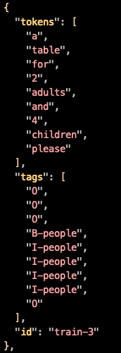
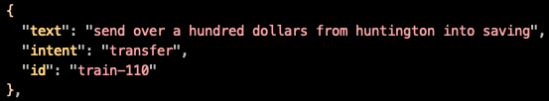
Data example in train.json
Slot Tagging
Intent Classification

Slide 17
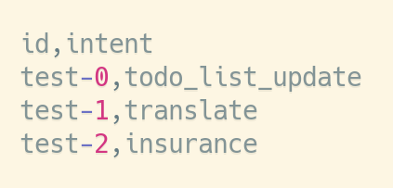
Submission Format - Intent Classification
CSV (Comma Separated Values) format with 2 columns:
id: Unique id for each sample
intent: Your prediction.

Slide 18
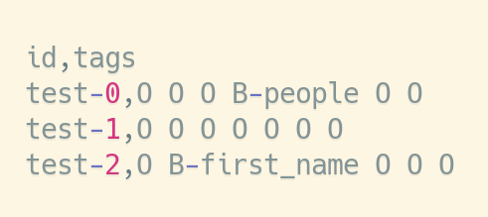
Submission Format - Slot Tagging
CSV (Comma Separated Values) format with 2 columns:
id: Unique id for each sample
tags: Your prediction. The tags should be separated with single space.

Slide 19
Logistics

Slide 20
Grading
Model Performance (10%)
Your intent classification model passes the baseline on the public test set (2%) and the private test set (3%) on kaggle
Your slot tagging model passes the baseline on the baseline on the public test set (2%) and the private test set (3%) on kaggle
Only if you can reproduce any submission that beats baseline in intent_cls.sh slot_tag.sh
Format (1%)
TA can run the grading script without human intervention.
Report (9% + 1% Bonus)
In PDF format!

Slide 21
Code/Scripts/Report Submission
Zip your folder into a single .zip file.
Submit to NTU Cool.

Slide 22
File Layout
Your zip must contain files (case sensitive):
/[student id (lower-cased)]/, ex. /r12922000/, no brackets
intent_cls.sh
slot_tag.sh
README.md
report.pdf
download.sh
Any other code/script.
Do not upload training, validation, testing data and model to COOL.

Slide 23
Submission Files - download.sh
download.sh to download your model.
Do not modify your file after deadline, or it will be seen as cheating.
Keep the URLs in download.sh valid for at least 2 weeks after deadline.
Do not do things more than downloading. Otherwise, your download.sh may be killed.
You can download at most 4G, and download.sh should finish within 1 hour.
You can upload your model to Dropbox. (see tutorial)
We will execute download.sh before predicting scripts.

Slide 24
Submission Files - Scripts
intent_cls.sh, slot_tag.sh
Corresponding to the intent classification model, slot tagging model
"${1}": path to the testing file.
"${2}": path to the output predictions.
TA will predict testing data as follow:
bash ./intent_cls.sh /path/to/test.json /path/to/pred.csv
Default python version would be 3.9 (Updated Sep. 22)
Make sure your code works!

Slide 25
Submission Files - Reproducibility
All the code you used to train, predict, plot figures for the report should should be upload.
README.md
Write down how to train your model with your code/script specifically.
If necessary, you will be required to reproduce your results based on the README.md.
If you cannot reproduce your result, you may lose points.
You will get at least - 2 penalty if you have no or empty README.md.

Slide 26
Execution Environment
Will be run on computer with
Ubuntu 20.04
32 GB RAM, GTX 3070 8G VRAM, 10G disk space available.
the packages we allow only.
python 3.9
Time limit 60 min for intent_cls.sh slot_tag.sh in total
No network access when predicting.
You will lose (some or all) your model performance score if
your script is at wrong location, or cause any error.

Slide 27
Rules

Slide 28
Kaggle
Displayed Team Name: [student_id]
e.g. r12345678
For auditing, Displayed Team Name: audit_[anything]
E.g. audit_4fun
You can submit your result 5 times a day for each task.
Any approaches to submit more than 5 times a day is prohibited!

Slide 29
What You Can Do
Train with the data we give you.
Use publicly available pre-trained word embeddings. (No contextualized word embedding.)
Use the packages/tools we allow:
Python 3.9 and Python Standard Library
PyTorch 1.12.1, TensorFlow 2.10.0, seqeval=1.2.2
tqdm, numpy, pandas, scikit-learn 1.1.2, nltk 3.7
Dependencies of above packages/tools.
If you want to use other package, COOL/mail TA.

Slide 30
What You Can NOT Do
Any means of cheating or plagiarism, including but not limited to:
Use others' code from anywhere (e.g. web, github, classmate, etc.).
Use the labels of the test data directly or indirectly. (Do not try to find them.)
Use package or tools not allowed.
Use model trained with other data.
Give/get model prediction to/from others.
Give/get trained model to/from others.
Publish your code before deadline.
Violation may cause zero/negative score and punishment from school.

Slide 31
Submission Policy
Submit to NTU Cool.
No Late submission.

Slide 32
Report

Slide 33
You may lose score if TA has difficulty understanding it.
Please write in a human-readable way.

Slide 34
When Describing Model
Please limit the use of imprecise words.
Use equation whenever possible.
Descriptions which is imprecise or hard to understand may cause loss of points.
Ex.
bad: Feed the embedding of the sentence into a LSTM.
good: h_{t}, c_{t} = LSTM(w_{t}, h_{t-1}, c_{t-1}), where w_{t} is the word embedding of the t-th token.

Slide 35
Q1: Data processing (2%)
Describe how do you use the data for intent_cls.sh, slot_tag.sh:
How do you tokenize the data.
The pre-trained embedding you used.
If you use the sample code, you will need to explain what it does in your own ways to answer Q1.

Slide 36
Q2: Describe your intent classification model. (2%)
Describe
your model
performance of your model. (public score on kaggle)
the loss function you used.
The optimization algorithm (e.g. Adam), learning rate and batch size.

Slide 37
Q3: Describe your slot tagging model. (2%)
Describe
your model
performance of your model. (public score on kaggle)
the loss function you used.
The optimization algorithm (e.g. Adam), learning rate and batch size.

Slide 38
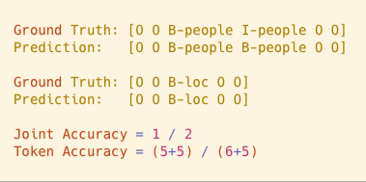
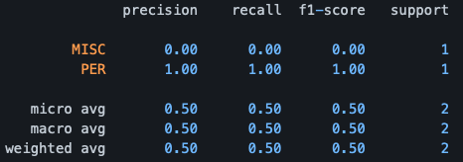
Q4: Sequence Tagging Evaluation (2%)
Please use seqeval to evaluate your model in Q3 on validation set and report classification_report(scheme=IOB2, mode=’strict’).
Explain the differences between the evaluation method in seqeval, token accuracy, and joint accuracy.

Slide 39
Q5: Compare with different configurations (1% + Bonus 1%)
Please try to improve your baseline method (in Q2 or Q3) with different configuration (includes but not limited to different number of layers, hidden dimension, GRU/LSTM/RNN) and EXPLAIN how does this affects your performance / speed of convergence / ...
Some possible BONUS tricks that you can try: multi-tasking, few-shot learning, zero-shot learning, CRF, CNN-BiLSTM
This question will be grade by the completeness of your experiments and your findings.

Slide 40
Guides

Slide 41
Pipeline for (Deep) NLP
Load pre-trained embedding (GloVe, ...).
Preprocess the dataset
Tokenize the sentences (SpaCy).
Convert token to word indices.
Prepare batch
Sample batch
Pad samples to the same length.
Train, check metrics on validation.
Predict!
Already written in the sample code

Slide 42
Slot Tagging Pipeline
Tag 0
Tag 1
…...
Tag N-1
Tag N
Calculate loss with labels
Token Prediction
P(Slot=xxx)
P(Slot=xxx)
P(Slot=xxx)
P(Slot=xxx)
P(Slot=xxx)
P(Slot=xxx)
P(Slot=xxx)
P(Slot=xxx)
Linear Layer
linear
linear
linear
linear
linear
linear
linear
linear
Recurrent Layer
Input Token
# tokens in text

Slide 43
Sample Code
Link
TA will not explain the sample code for you.
You can also write from scratch.
Any bug report is welcome!
See READMD.md for instructions

